Slide 1
SAT & ACT
Insights into

Slide 2
OVERVIEW
SAT & ACT: What are they and how do they differ?
Introduction to our data sets
Analysis
Recommendation

Slide 3
Introduction to sat & act
 | SAT |  | ACT
SECTIONS | MATH/EVIDENCE-BASED READING |  | MATH / READING / ENGLISH / SCIENCE
SCORING | 200 - 800 PER SECTION 400 - 1600 TOTAL SCORE |  | 1 - 36 PER SECTION 1 - 36 AVERAGE COMPOSITE SCORE
TIME | 2 HRS 55 MINS (WITHOUT WRITING) |  | 3 HRS (WITHOUT ESSAY)
COST | $50.50 (WITHOUT WRITING) $67.00 (WITH WRITING) |  | $47.50 (WITHOUT ESSAY) $64.50 (WITH ESSAY)

Slide 4
THE DATA
Class of 2017 and 2018 (by state level)
SAT features: Participation rate, section score, total score
ACT features: Participation rate, section score, composite score
2017: Data provided
2018: Both datasets extracted from online sources (College Board, education website)

Slide 5
Goals
Clean the data and prepare them to analysis
Go through exploratory data analysis and discover patterns
Examine patterns and visualise them
Provide recommendations to the College Board to increase participation rates

Slide 6
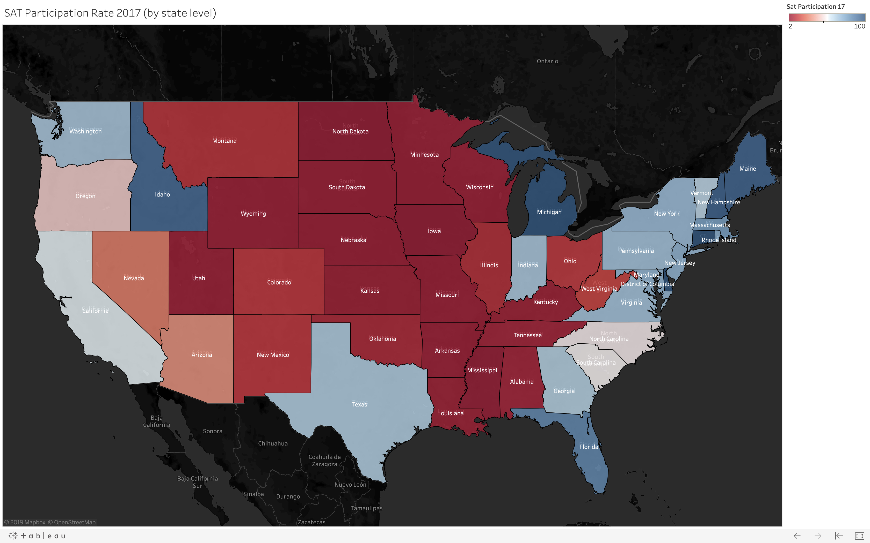
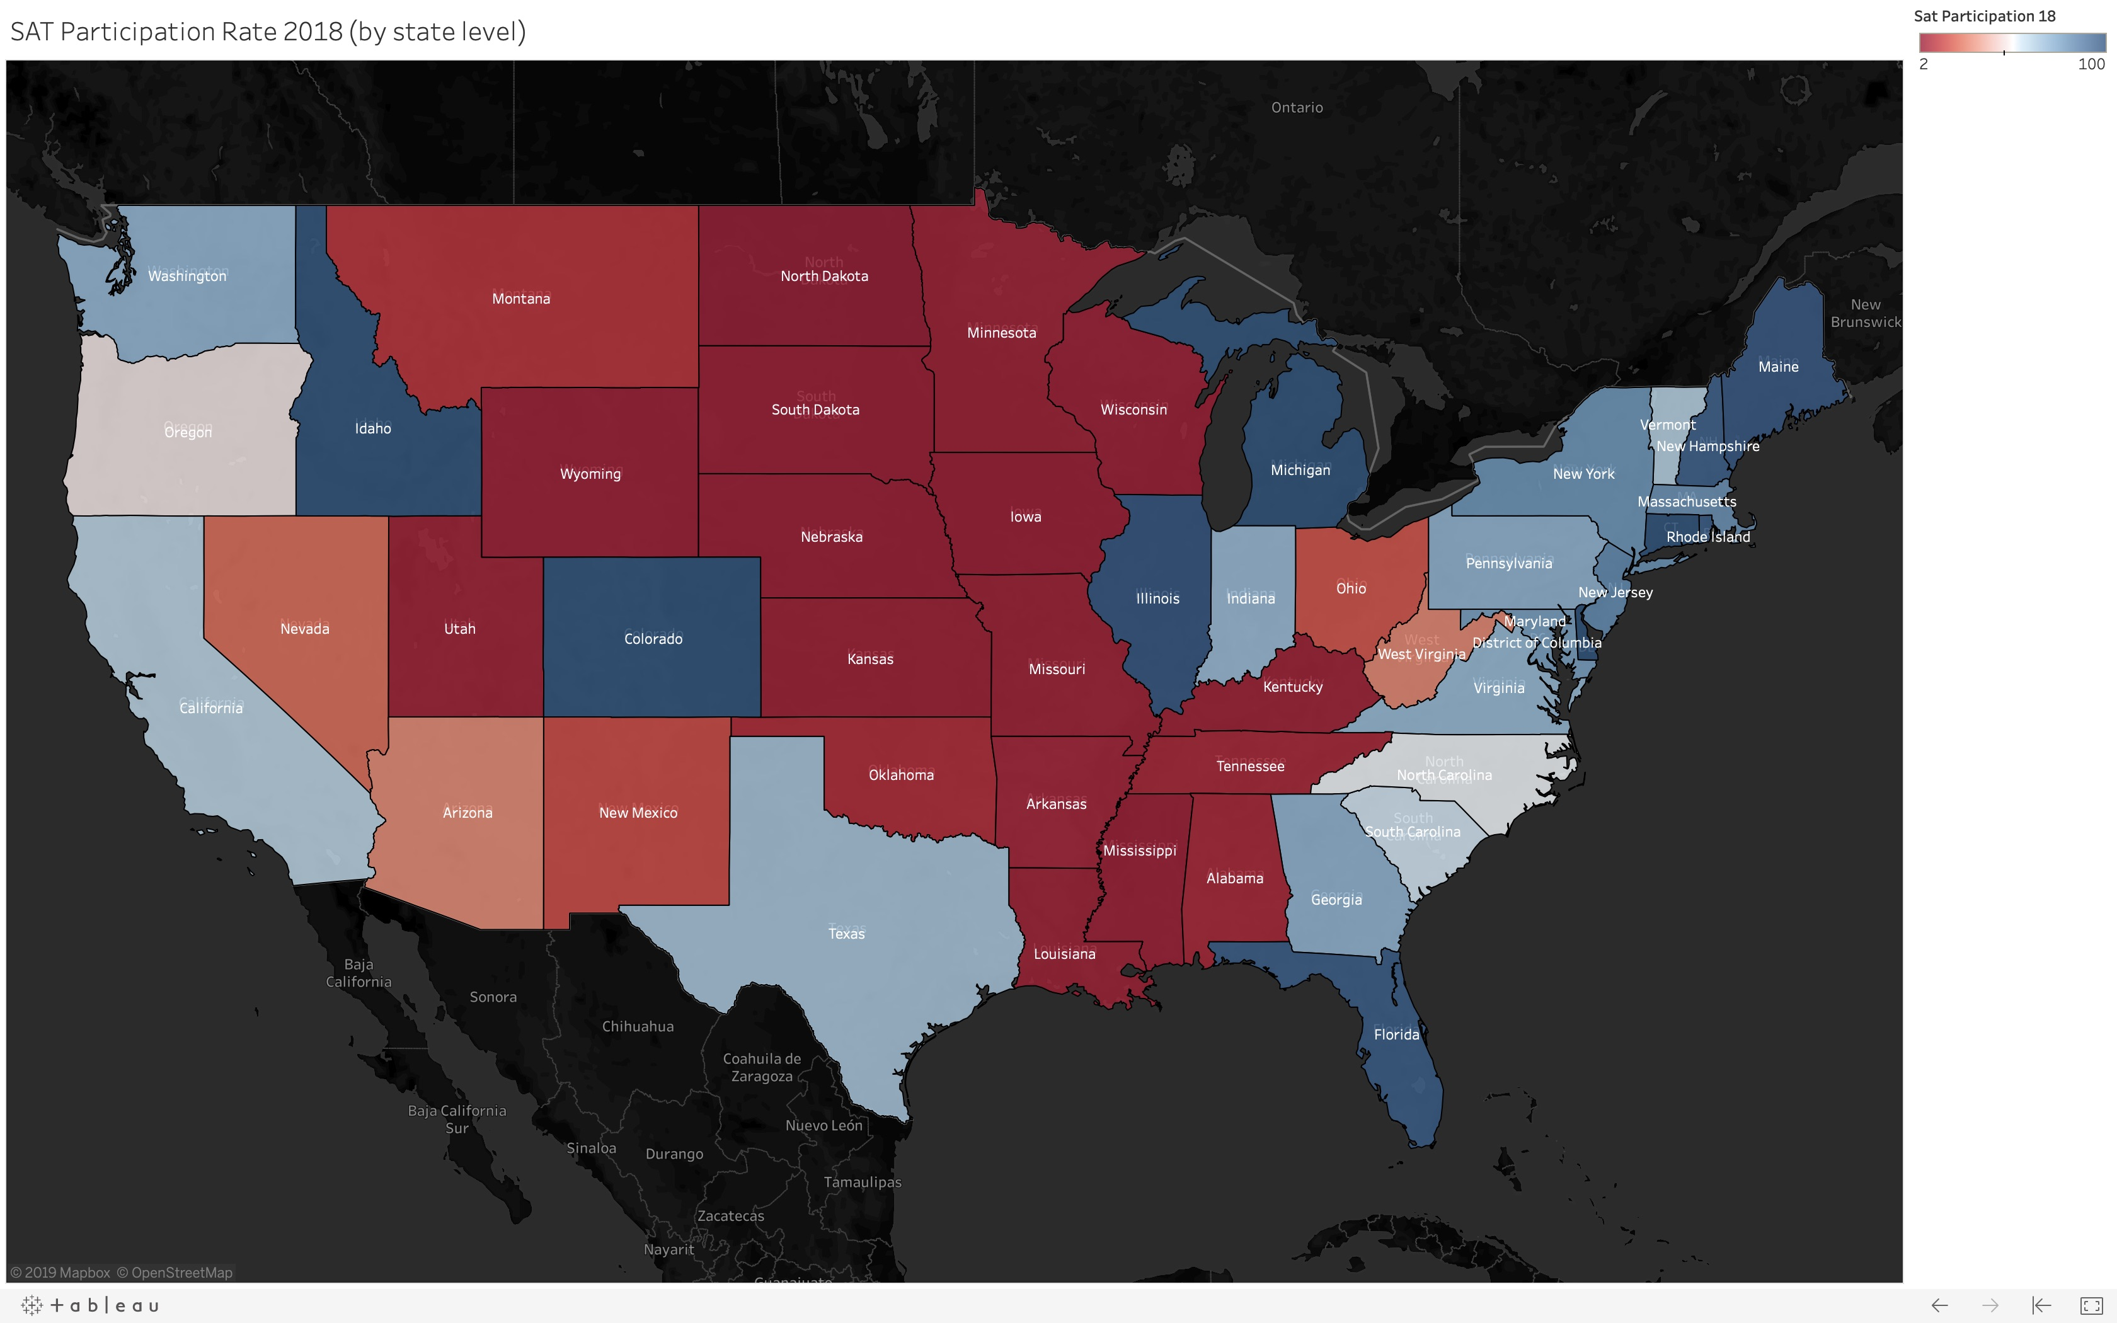
SAT participation
2017
2018
Coastal states have higher participation rates
Big swings: Colorado, Illinois
Balanced: North Carolina, South Carolina, Oregon

Slide 7
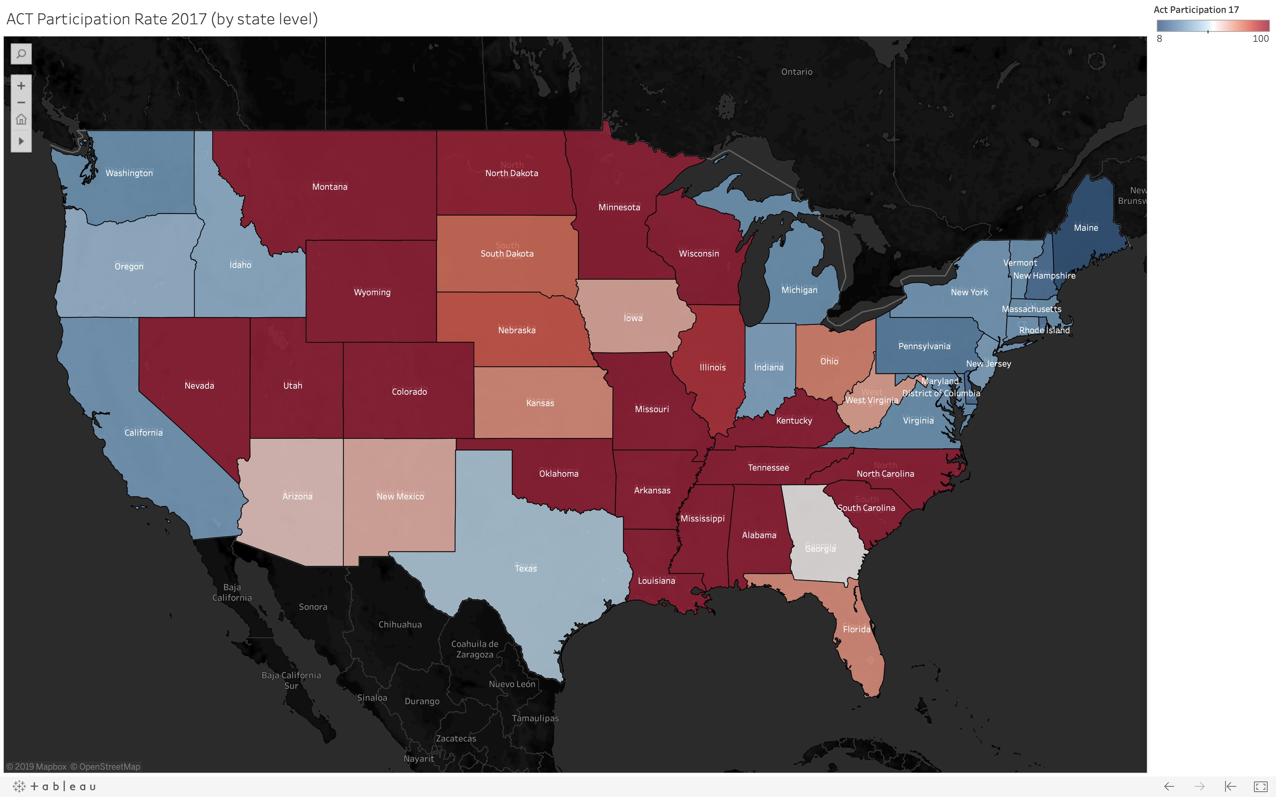
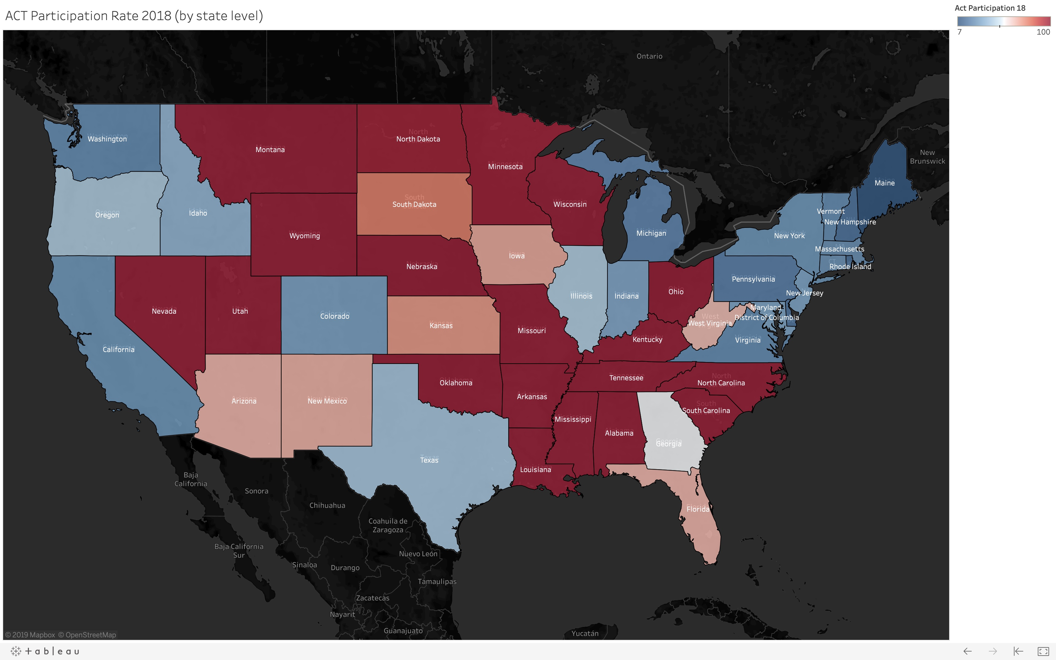
ACT participation
2017
2018
Southern and Rocky Mountain states dominate
Big swings: Colorado, Illinois
Balanced: Georgia

Slide 8
Participation: The ups and downs
SAT participation rose significantly
ACT participation drops slightly

Slide 9
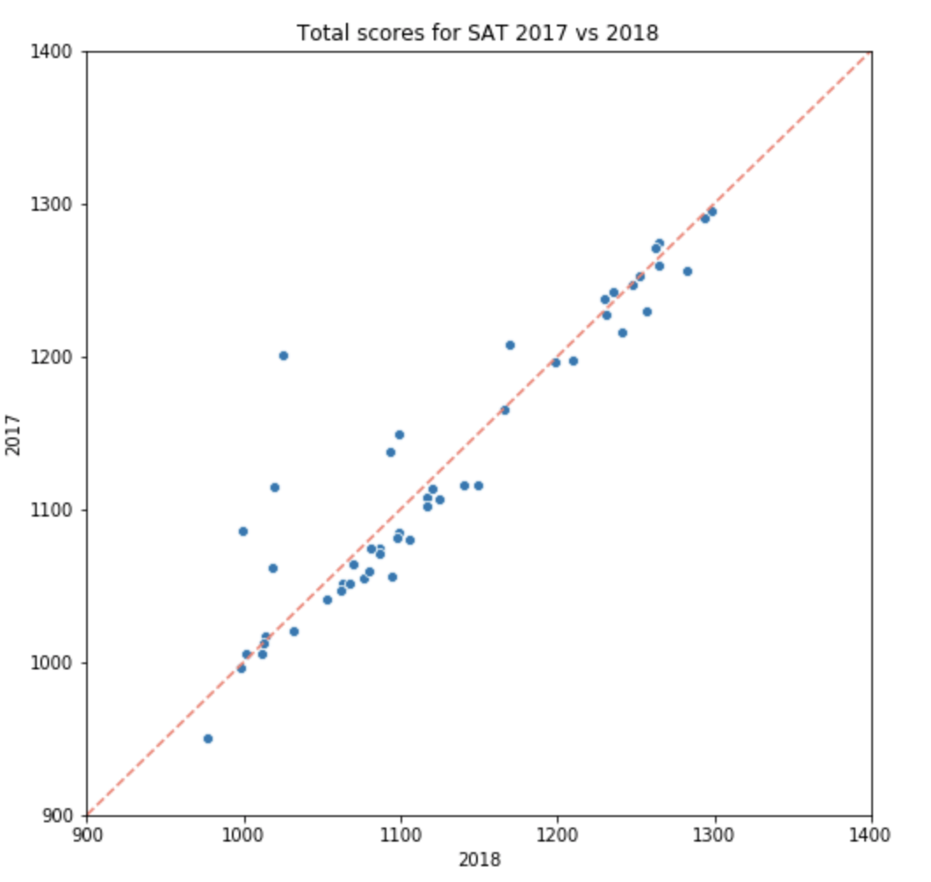
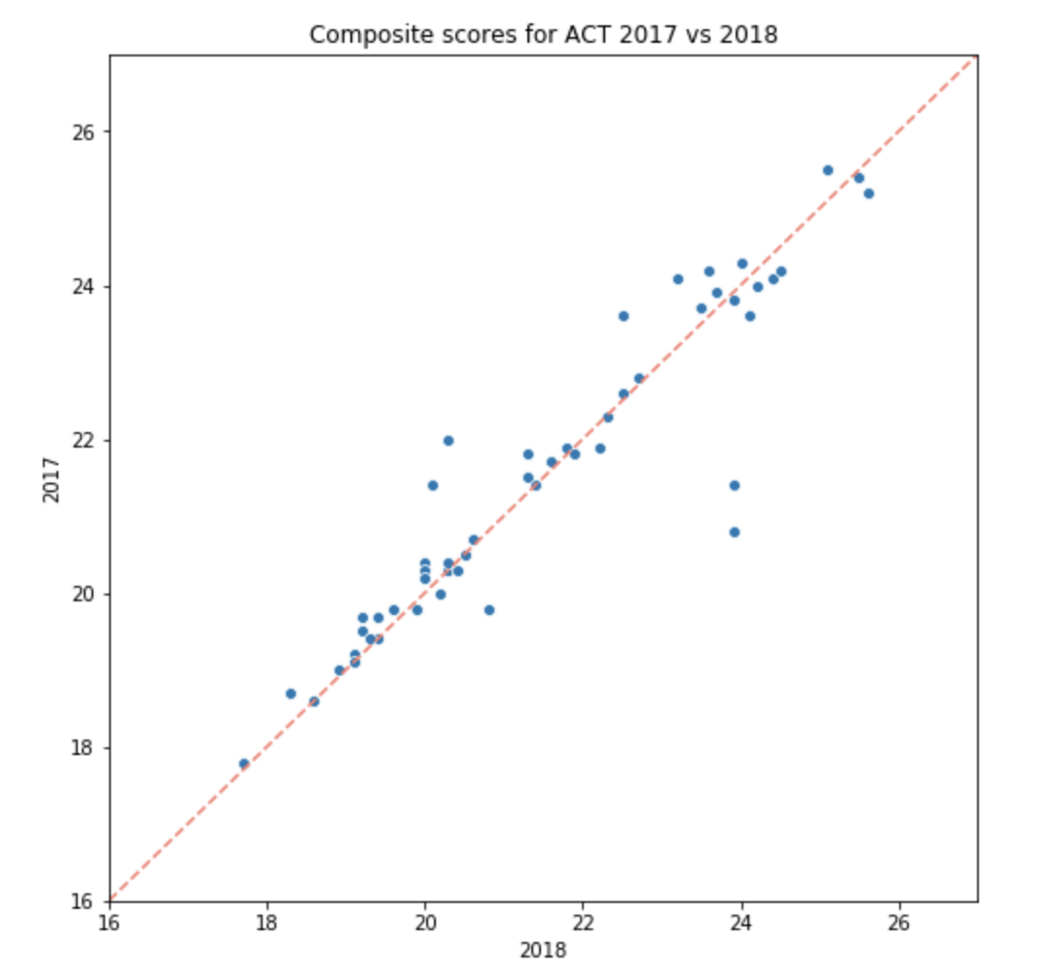
which graduating class did better?
SAT
ACT

Slide 10
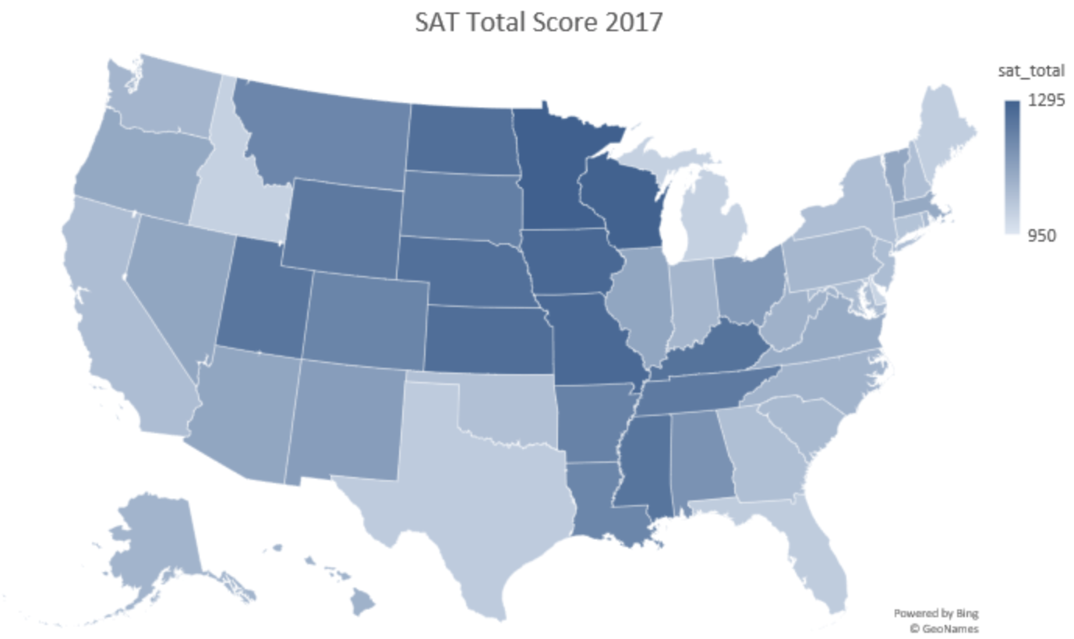
Total score: state comparison (SAT)

Slide 11
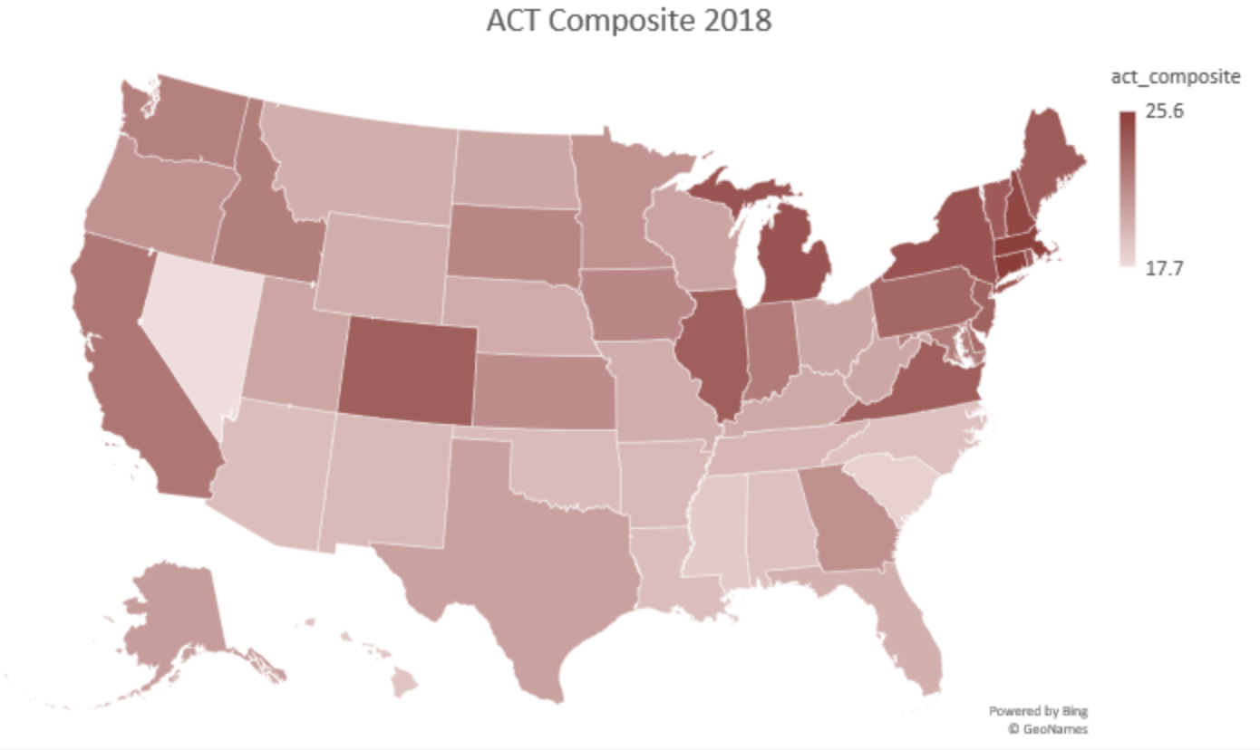
Total score: state comparison (ACT)

Slide 12
colorado: so long and farewell, act
Lawmakers vote for Dept. of Education to take bids for college entrance exam in 2015
2015: State picks SAT as state-wide testing requirement
SAT chosen as state-wide college testing requirement: high schoolers to take test, juniors primed via PSAT
Transition: High school juniors start in 2016
100% participation attained in 2018

Slide 13
Florida: victory cigar in sight?
Florida has the highest combined participation rate in 2018.
Students must pass exit exams or achieved specified scores on ACT or SAT.
14% YOY increase for SAT.
Why? Free test sessions provided by schools.

Slide 14
What the college board should do
Influence state school districts and push them them to include PSAT for high school juniors.
Fee waivers to cover test costs: lower entry barrier for lower-income students.
SAT School Days: Offer to as many schools as possible. Making tests as convenient as possible means students are more likely to take up the test.
Create more partnerships with study platforms to make it easier for students to learn and practise the tests (Khan Academy). It’s s a form of advertisement as well, making the SAT brand stand out.
Make more visits to schools: educate the students on the possibilities that lie ahead for them, of which a college-bound education should be made prominent.
Hold talks or conferences near schooling districts, success college stories stemming from a good SAT score make for good product placements.

